Slide 1
Gestão estratégica
9

Slide 2
Objectivos
Definir a gestão estratégica e explicar a sua importância.
Explicar o que os gestores fazem nos seis passos do processo de gestão estratégica.
Descrever os três tipos de estratégias organizacionais.
Descrever a vantagem competitiva e as estratégias competitivas usadas para a atingir.
Discutir tópicos atuais sobre a gestão estratégica.

Slide 3
O que é a Gestão estratégica?
Gestão Estratégica – o que os gestores fazem para desenvolver as estratégias, para as suas organizações.
Estratégias – os planos que a organização tem para prosseguir o seu propósito, definindo como irá competir com os concorrentes e atrair e satisfazer os seus clientes, para atingir os seus objectivos.
Modelo de Negócio – como a organização vai fazer dinheiro.
Notes:
Strategic management is what managers do to develop the organization’s strategies. It’s an important task involving all the basic management functions—planning, organizing, leading, and controlling. What are an organization’s strategies? They’re the plans for how the organization will do whatever it’s in business to do, how it will compete successfully, and how it will attract and satisfy its customers in order to achieve its goals.
One term often used in strategic management is business model, which simply is how a company is going to make money. It focuses on two things: (1) whether customers will value what the company is providing, and (2) whether the company can make any money doing that.

Slide 4
Porque é que a Gestão estratégica é importante?
Porque resulta num melhor desempenho organizacional.
Porque força os gestores a examinarem e a adaptarem-se às mudanças no meio-ambiente da organização.
Porque implica a coordenação das diversas unidades organizacionais, que assim são orientadas para se adaptarem aos objetivos organizacionais.
Notes:
Why is strategic management so important? There are three reasons. The most significant one is that it can make a difference in how well an organization performs. In other words, it appears that organizations that use strategic management do have higher levels of performance. And that fact makes it pretty important for managers.
Another reason it’s important has to do with the fact that managers in organizations of all types and sizes face continually changing situations. They cope with this uncertainty by using the strategic management process to examine relevant factors and decide what actions to take.
Finally, strategic management is important because organizations are complex and diverse. Each part needs to work together toward achieving the organization’s goals; strategic management helps do this.

Slide 5
Processo de Gestão estratégica
Processo de Gestão Estratégica
Um processo de seis etapas que compreende o planeamento estratégico, a implementação e a avaliação.
Notes:
The strategic management process (see Exhibit 9-1) is a six-step process that encompasses strategy planning, implementation, and evaluation. Although the first four steps describe the planning that must take place, implementation and evaluation are just as important! Even the best strategies can fail if management doesn’t implement or evaluate them properly.

Slide 6
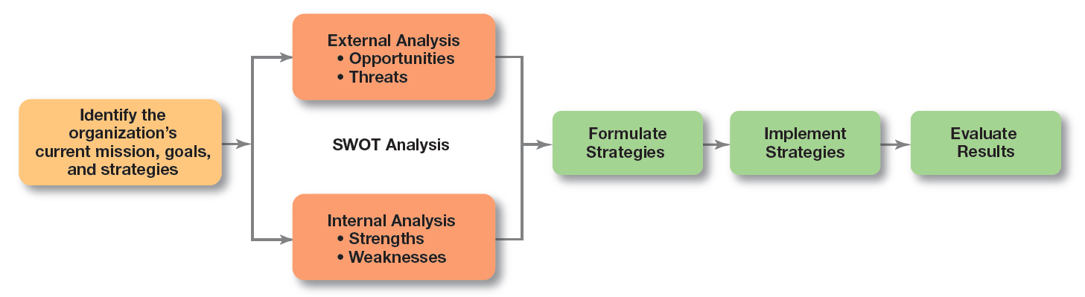
figura 9-1
Processo de Gestão estratégica

Slide 7
Processo de Gestão estratégica (cont.)
Etapa 1: Identificar a missão, os objetivos e as estratégias presentes, da organização.
  Missão: uma declaração do propósito da organização.
    Que tipo de produtos e serviços.
  Objetivos: a fundação do planeamento.
    Objetivos de desempenho mensuráveis.
Notes:
Every organization needs a mission—a statement of its purpose. Defining the mission forces managers to identify what it’s in business to do. But sometimes that mission statement can be too limiting. For example, the co-founder of the leading Internet search engine Google says that while the company’s purpose of “organizing the world’s information and making it universally accessible and useful” has served them well, they failed to see the whole social side of the Internet and have been playing catch-up.

Slide 8
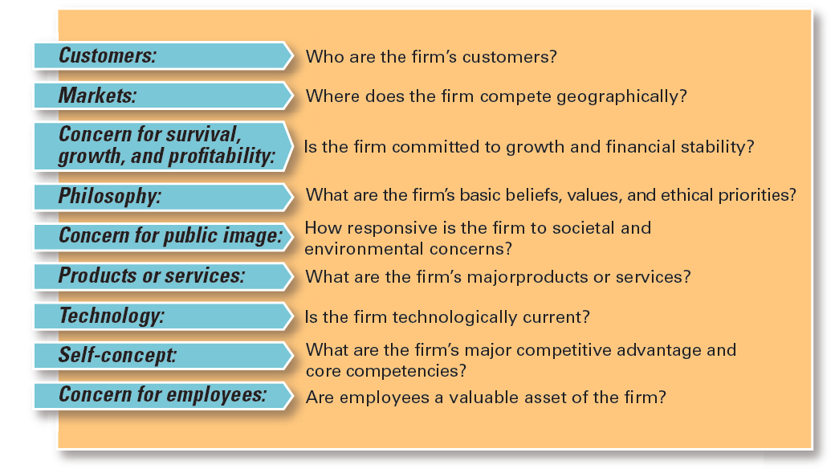
figura 9-2
Componentes da missão
Notes:
What should a mission statement include? Exhibit 9-2 describes some typical components.

Slide 9
Processo de Gestão estratégica (cont.)
Etapa 2: Elaborar uma análise externa.
  Análise do meio-ambiente específico e geral da organização.
    A identificação das oportunidades e ameaças.
Notes:
Analyzing that environment is a critical step in the strategic management process. Managers do an external analysis so they know, for instance, what the competition is doing, what pending legislation might affect the organization, or what the labor supply is like in locations where it operates. In an external analysis, managers should examine the economic, demographic, political/legal, sociocultural, technological, and global components to see the trends and changes.
Once they’ve analyzed the environment, managers need to pinpoint opportunities that the organization can exploit and threats that it must counteract or buffer against. Opportunities are positive trends in the external environment; threats are negative trends.

Slide 10
Processo de Gestão estratégica (cont.)
Etapa 3: Elaborar uma análise interna
  Avaliar os recursos, capacidades e actividades da organização:
    As forças criam valor para os clientes e fortalecem a posição competitiva da organização.
    As fraquezas podem colocar a organização numa posição competitiva desvantajosa.
Notes:
The internal analysis provides important information about an organization’s specific resources and capabilities. An organization’s resources are its assets—financial, physical, human, and intangible—that it uses to develop, manufacture, and deliver products to its customers. They’re “what” the organization has. On the other hand, its capabilities are its skills and abilities in doing the work activities needed in its business—“how” it does its work. The major value-creating capabilities of the organization are known as its core competencies.
After completing an internal analysis, managers should be able to identify organizational strengths and weaknesses. Any activities the organization does well or any unique resources that it has are called strengths. Weaknesses are activities the organization doesn’t do well or resources it needs but doesn’t possess.

Slide 11
Processo de Gestão estratégica (cont.)
Etapa 2: Elaborar uma análise externa.
Etapa 3: Elaborar uma análise interna
  As etapas 2 e 3, combinadas, são designadas por análise SWOT. (Strengths, Weaknesses, Opportunities, and Threats)
Notes:
The internal analysis provides important information about an organization’s specific resources and capabilities. An organization’s resources are its assets—financial, physical, human, and intangible—that it uses to develop, manufacture, and deliver products to its customers. They’re “what” the organization has. On the other hand, its capabilities are its skills and abilities in doing the work activities needed in its business—“how” it does its work. The major value-creating capabilities of the organization are known as its core competencies.
After completing an internal analysis, managers should be able to identify organizational strengths and weaknesses. Any activities the organization does well or any unique resources that it has are called strengths. Weaknesses are activities the organization doesn’t do well or resources it needs but doesn’t possess.

Slide 12
Análise SWOT
Análise SWOT – uma análise das forças, fraquezas, oportunidades e ameaças.
Recursos – os ativos da organização que são usados para desenvolver, produzir e entregar os produtos/serviços aos seus clientes.
Capacidades - as competências e conhecimento que a organização tem para trabalhar no seu negócio.
Notes:
The combined external and internal analyses are called the SWOT analysis, an analysis of the organization’s strengths, weaknesses, opportunities, and threats. After completing the SWOT analysis, managers are ready to formulate appropriate strategies—that is, strategies that (1) exploit an organization’s strengths and external opportunities, (2) buffer or protect the organization from external threats, or (3) correct critical weaknesses.

Slide 13
Forças e fraquezas
Forças – actividades que a organização faz bem, ou recurso/competência/capacidade único(a) que detém.
Competências fundamentais (Core) – competências mais criadoras de valor e que determinam a sua capacidade competitiva.
Fraquezas - actividades que a organização não faz bem, ou recurso/competência/capacidade necessários(as) que não detém.

Slide 14
Processo de Gestão estratégica (cont.)
Etapa 4: Formulação de estratégias
  Desenvolver e avaliar diferentes estratégias alternativas.
  Seleccionar as estratégias apropriadas, para todos os níveis na organização, que tenham potencial para criar uma vantagem competitiva face aos concorrentes.
  Ligar as forças internas da organização às oportunidades do ambiente externo.
  Corrigir as fraquezas internas e evitar ou proteger-se das ameaças externas.
Notes:
As managers formulate strategies, they should consider the realities of the external environment and their available resources and capabilities in order to design strategies that will help an organization achieve its goals. The three main types of strategies managers will formulate include corporate, competitive, and functional.

Slide 15
Processo de Gestão estratégica (cont.)
Etapa 5: Implementar as estratégias
  Implementação – adaptar, de forma eficaz, a estrutura e actividades da organização ao meio-ambiente.
  O meio-ambiente “define” a estratégia a escolher; Uma implementação eficaz da estratégia requer uma estrutura organizacional apropriada.
Notes:
Once strategies are formulated, they must be implemented. No matter how effectively an organization has planned its strategies, performance will suffer if the strategies aren’t implemented properly.
The final step in the strategic management process is evaluating results. How effective have the strategies been at helping the organization reach its goals? What adjustments are necessary?

Slide 16
Processo de Gestão estratégica (cont.)
Etapa 6: Avaliar os resultados
  Quão eficazes foram as estratégias?
  Que ajustamentos são, eventualmente, necessários?
Notes:
Once strategies are formulated, they must be implemented. No matter how effectively an organization has planned its strategies, performance will suffer if the strategies aren’t implemented properly.
The final step in the strategic management process is evaluating results. How effective have the strategies been at helping the organization reach its goals? What adjustments are necessary?

Slide 17
Estratégia corporative – nível organizacional
Estratégia Corporativa – um tipo de estratégia organizacional que determina em que negócios a organização está, ou pretende estar, e o que pretende fazer com esses negócios.
Unidade estratégica de negócio (UEN) – uma unidade de negócio independente, com estratégias competitivas próprias.
Notes:
A corporate strategy is one that determines what businesses a company is in or wants to be in and what it wants to do with those businesses. It’s based on the mission and goals of the organization and the roles that each business unit of the organization will play.
When an organization is in several different businesses, those single businesses that are independent and that have their own competitive strategies are referred to as strategic business units (SBUs).

Slide 18
Tipos de estratégias Corporativas
Crescimento - expansão para novos produtos/serviços e/ou mercados.
Estabilidade – manutenção do status quo.
Renovação – avaliar e atuar sobre as fraquezas da organização, quando estas estão a condicionar negativamente o seu desempenho.
Notes:
The three main types of corporate strategies are growth, stability, and renewal. Let’s look at each type.

Slide 19
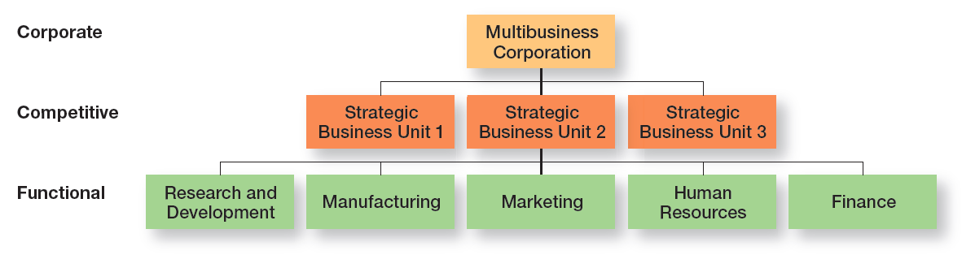
figura 9-3
Tipos de estratégias corporativas

Slide 20
Estratégia de crescimento
Estratégia de Crescimento
Estratégia corporativa que é usada quando a organização pretende expandir o número de mercados que serve, ou produtos/serviços que oferece, através dos actuais negócio(s), ou através de novo(s) negócio(s).
Notes:
A growth strategy is when an organization expands the number of markets served or products offered, either through its current business(es) or through new business(es). Because of its growth strategy, an organization may increase revenues, number of employees, or market share. Organizations grow by using concentration, vertical integration, horizontal integration, or diversification.

Slide 21
Tipos de estratégias de crescimento
Estratégia de Concentração
Focalização na principal linha de negócio da organização, aumentando o número de produtos oferecidos e/ou mercados, mas tudo isto dentro dessa principal linha de negócio.
Notes:
An organization that grows using concentration focuses on its primary line of business and increases the number of products offered or markets served in this primary business.
A company also might choose to grow by vertical integration, either backward, forward, or both. In backward vertical integration, the organization becomes its own supplier so it can control its inputs. In forward vertical integration, the organization becomes its own distributor and is able to control its outputs.

Slide 22
Tipos de estratégias de crescimento
Estratégia de Integração vertical
  Integração vertical a montante - a organização torna-se no seu próprio fornecedor.
  Integração vertical a jusante - a organização torna-se no seu próprio distribuidor.
  Estratégia de Integração horizontal
  A organização estabelece parceria, adquire, ou funde-se com um, ou mais, concorrentes.
Notes:
An organization that grows using concentration focuses on its primary line of business and increases the number of products offered or markets served in this primary business.
A company also might choose to grow by vertical integration, either backward, forward, or both. In backward vertical integration, the organization becomes its own supplier so it can control its inputs. In forward vertical integration, the organization becomes its own distributor and is able to control its outputs.

Slide 23
Tipos de estratégias de crescimento (cont.)
Estratégia de Diversificação
  Diversificação relacionada - crescimento para novas, mas relacionadas, indústrias.
  Diversificação não relacionada - crescimento para novas indústrias, as quais não estão relacionadas com os seus actuais negócios.
Notes:
In horizontal integration, a company grows by combining with competitors. Finally, an organization can grow through diversification, either related or unrelated. Related diversification happens when a company combines with other companies in different, but related industries. Unrelated diversification is when a company combines with firms in different and unrelated industries.

Slide 24
Tipos de estratégias Corporativas (Cont.)
Estratégia de Estabilidade
A estratégia corporativa através da qual a organização pretende continuar a fazer o que actualmente faz.
Notes:
A stability strategy is a corporate strategy in which an organization continues to do what it is currently doing. Examples of this strategy include continuing to serve the same clients by offering the same product or service, maintaining market share, and sustaining the organization’s current business operations. The organization doesn’t grow, but doesn’t fall behind, either.

Slide 25
Tipos de estratégias Corporativas (Cont.)
Estratégia de Renovação
Estratégica corporativa concebida para actuar sobre um problema de performance decrescente.
  Estratégia de restrição (melhoria da eficiência / redução de custos) - estratégia de curto-prazo para resolver pequenas questões de performance.
  Estratégia de recuperação (Turnaround) – quando os problemas da organização são mais sérios e são necessárias acções mais drásticas.
Notes:
When an organization is in trouble, something needs to be done. Managers need to develop strategies, called renewal strategies, that address declining performance. The two main types of renewal strategies are retrenchment and turnaround strategies. A retrenchment strategy is a short-run renewal strategy used for minor performance problems. This strategy helps an organization stabilize operations, revitalize organizational resources and capabilities, and prepare to compete once again. When an organization’s problems are more serious, more drastic action—the turnaround strategy—is needed. Managers do two things for both renewal strategies: cut costs and restructure organizational operations. However, in a turnaround strategy, these measures are more extensive than in a retrenchment strategy.

Slide 26
Como são geridas as estratégias corporativas
Matriz BCG – uma ferramenta estratégica que auxilia os gestores a decidir sobre a alocação de recursos, com base na quota de mercado e na taxa de crescimento prevista das UEN.
Quatro Categorias
  Estrelas (Stars)
  Vacas Leiteiras (Cash-cows)
  Pontos de Interrogação (Question Marks)
  Cães Rafeiros (Dogs)
Notes:
The BCG matrix— was developed by the Boston Consulting Group and introduced the idea that an organization’s various businesses could be evaluated and plotted using a 2 × 2 matrix to identify which ones offered high potential and which were a drain on organizational resources. The horizontal axis represents market share (low or high), and the vertical axis indicates anticipated market growth (low or high). A business unit is evaluated using a SWOT analysis and placed in one of the four categories, which are as follows:
• Stars: High market share/High anticipated growth rate
• Cash Cows: High market share/Low anticipated growth rate
• Question Marks: Low market share/High anticipated growth rate
• Dogs: Low market share/Low anticipated growth rate

Slide 27
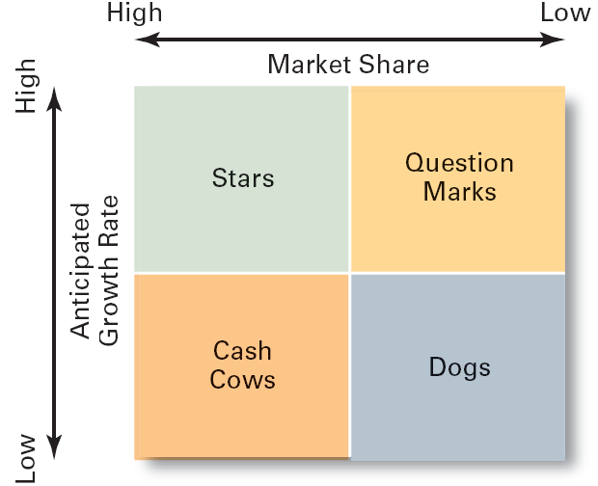
Matriz BCG

Slide 28
Estratégias Competitivas – nível dos negócios
Estratégias Competitivas – estratégias organizacionais que definem como a organização irá competir no(s) seu(s) negócio(s).
Vantagem Competitiva – o que diferencia a organização e a coloca à frente dos seus concorrentes.
  A qualidade como vantagem competitiva
  Design Thinking como vantagem competitiva
  A sustentabilidade de uma vantagem competitiva
Notes:
Developing an effective competitive strategy requires an understanding of competitive advantage, which is what sets an organization apart—that is, its distinctive edge

Slide 29
Modelo das cinco forças
(Michael Porter, 1979)
Modelo das cinco forças
As 5 forças que determinam a atratividade e rendibilidade de uma indústria;
Ameaça de novas entradas – quão provável é que novos concorrentes entrem na indústria?
Ameaça de produtos substitutos - quão provável é que produtos de outras indústrias possam substituir os produtos da indústria?
Notes:
In any industry, five competitive forces dictate the rules of competition. Together, these five forces determine industry attractiveness and profitability, which managers assess using these five factors.
Threat of new entrants. How likely is it that new competitors will come into the industry?
Threat of substitutes. How likely is it that other industries’ products can be substituted for our industry’s products?

Slide 30
Modelo das cinco forças (cont.)
Poder negocial dos clientes - Quanto poder têm?
Poder negocial dos fornecedores - Quanto poder têm?
5. Nível de concorrência - Quão intensa é a rivalidade entre os concorrentes da indústria?
Notes:
3. Bargaining power of buyers. How much bargaining power do buyers (customers) have?
4. Bargaining power of suppliers. How much bargaining power do suppliers have?
5. Current rivalry. How intense is the rivalry among current industry competitors?

Slide 31
Estratégias competitivas
Liderança pelos custos – quando a organização decide competir com base nos mais baixos custos da sua indústria (maior eficiência possível).
Diferenciação - quando a organização decide competir com base na oferta de produtos/serviços exclusivos e especialmente valorizados pelos clientes.
Nicho — Focada num segmento específico/limitado do mercado (poderá ser conseguida por uma liderança pelos custos, ou por diferenciação).
Notes:
When an organization competes on the basis of having the lowest costs (costs or expenses, not prices) in its industry, it’s following a cost leadership strategy. A low-cost leader is highly efficient. Overhead is kept to a minimum, and the firm does everything it can to cut costs.
A company that competes by offering unique products that are widely valued by customers is following a differentiation strategy. Product differences might come from exceptionally high quality, extraordinary service, innovative design, technological capability, or an unusually positive brand image. Practically any successful consumer product or service can be identified as an example of the differentiation strategy.

Slide 32
Estratégias competitivas (cont.)
Imobilizadas no meio (Stuck in the middle)
Quando os custos são demasiado altos, para competir numa liderança pelos custos, e os produtos/serviços não são suficientemente diferentes, para competir pela diferenciação.
Notes:
Although these two competitive strategies are aimed at the broad market, the final type of competitive strategy—the focus strategy—involves a cost advantage (cost focus) or a differentiation advantage (differentiation focus) in a narrow segment or niche. Segments can be based on product variety, customer type, distribution channel, or geographical location.
What happens if an organization can’t develop a cost or a differentiation advantage? Porter called that being stuck in the middle and warned that’s not a good place to be. An organization becomes stuck in the middle when its costs are too high to compete with the low-cost leader or when its products and services aren’t differentiated enough to compete with the differentiator. Getting unstuck means choosing which competitive advantage to pursue and then doing so by aligning resource, capabilities, and core competencies.

Slide 33
Estratégias funcionais
Estratégias Funcionais
Estratégias usadas pelos vários departamentos para implementar a estratégia competitiva.
Notes:
Functional strategies are the strategies used by an organization’s various functional departments to support the competitive strategy.

Slide 34
Tópicos atuais sobre a liderança estratégica
Liderança Estratégica
A capacidade de antecipar, prever, manter flexibilidade, pensar estrategicamente e trabalhar com outros na organização, para provocar mudanças que irão criar valor para a organização.
…Para estar sempre um passo à frente.
Notes:
An organization’s strategies are usually developed and overseen by its top managers. An organization’s top manager is typically the CEO (chief executive officer). This individual usually works with a top management team that includes other executive or senior managers such as a COO (chief operating officer), CFO (chief financial officer), CIO (chief information officer), and other individuals who may have various titles. Traditional descriptions of the CEO’s role in strategic management include being the “chief ” strategist, structural architect, and developer of the organization’s information/control systems. Strategic leadership is the ability to anticipate, envision, maintain flexibility, think strategically, and work with others in the organization to initiate changes that will create a viable and valuable future for the organization.

Slide 35
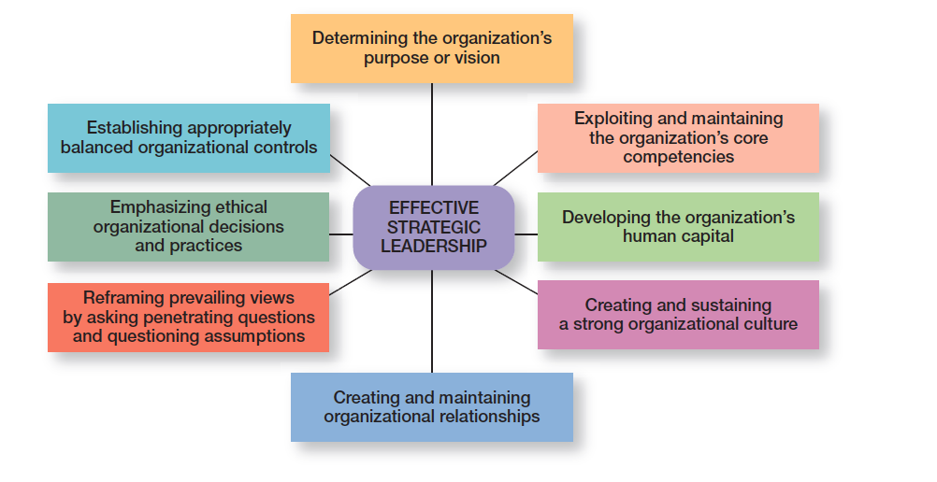
figura 9-4 liderança estratégica eficaz
Notes:
How can top managers provide effective strategic leadership? Eight key dimensions have been identified. (See Exhibit 9-4.) These dimensions include determining the organization’s purpose or vision, exploiting and maintaining the organization’s core competencies, developing the organization’s human capital, creating and sustaining a strong organizational culture, creating and maintaining organizational relationships, reframing prevailing views by asking penetrating questions and questioning assumptions, emphasizing ethical organizational decisions and practices, and establishing appropriately balanced organizational controls. Each dimension encompasses an important part of the strategic management process.

Slide 36
Tópicos atuais sobre a liderança estratégica (Cont.)
Flexibilidade Estratégica
A capacidade para reconhecer as grandes mudanças externas, para rapidamente alocar e realocar recursos e para adaptar ou reformular as decisões estratégicas (quando estas não forem as mais apropriadas).
Notes:
Strategic flexibility is the ability to recognize major external changes, to quickly commit resources, and to recognize when a strategic decision isn’t working. Given the highly uncertain environment that managers face today, strategic flexibility seems absolutely necessary!

Slide 37
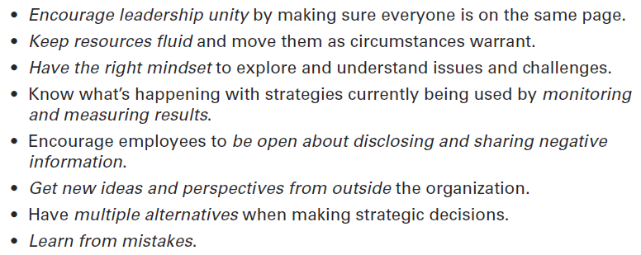
figura 9-5
Desenvolver a flexibilidade estratégica

Slide 38
Estratégias organizacionais Importantes no ambiente atual
Estratégias e-Business
  Liderança pelos custos – reduzir os custos através de actividades on-line: recrutamento, negociação, processamento de encomendas, control de stocks, etc.
  Diferenciação – Procurar a exclusividade através de sistemas de informação baseados na Internet: encomendas online e apoio ao cliente, etc.
  Nicho – Conhecer e ser reconhecido nesse segmento do mercado através de: forum(ra) na internet, chat rooms, páginas na internet, etc.
Notes:
Managers use e-business strategies to develop a sustainable competitive advantage. Cost leaders can use e-business to lower costs in a variety of ways. For instance, it might use online bidding and order processing to eliminate the need for sales calls and to decrease sales force expenses; it could use Web-based inventory control systems that reduce storage costs; or it might use online testing and evaluation of job applicants. A differentiator needs to offer products or services that customers perceive and value as unique. For instance, a business might use Internet-based knowledge systems to shorten customer response times, provide rapid online responses to service requests, or automate purchasing and payment systems so that customers have detailed status reports and purchasing histories. Finally, because the focuser targets a narrow market segment with customized products, it might provide chat rooms or discussion boards for customers to interact with others who have common interests, design niche Web sites that target specific groups with specific interests, or use Web sites to perform standardized office functions such as payroll or budgeting.

Slide 39
Estratégias organizacionais Importantes no ambiente atual (Cont.)
Estratégias de serviço ao cliente
Para promover a excelência no serviço ao cliente são necessárias estratégias que criem um ambiente interno apropriado.
Estratégias de Inovação
  Ser o primeiro (First Mover) – organizações que lideram a introdução dos novos produtos, serviços ou processos no mercado.
Notes:
Having an effective customer communication system is an important customer service strategy. Managers should know what’s going on with customers. They need to find out what customers liked and didn’t like about their purchase encounter—from their interactions with employees to their experience with the actual product or service. It’s also important to let customers know if something is going on with the company that might affect future purchase decisions. Finally, an organization’s culture is important to providing excellent customer service. This typically requires that employees be trained to provide exceptional customer service.
Innovation strategies aren’t necessarily focused on just the radical, breakthrough products. They can include applying existing technology to new uses. And organizations have successfully used both approaches. What types of innovation strategies do organizations need in today’s environment? Those strategies should reflect their innovation philosophy, which is shaped by two strategic decisions: innovation emphasis and innovation timing.
An organization that’s first to bring a product innovation to the market or to use a new process innovation is called a first mover. Being a first mover has certain strategic advantages and disadvantages as shown in Exhibit 9-6.

Slide 40
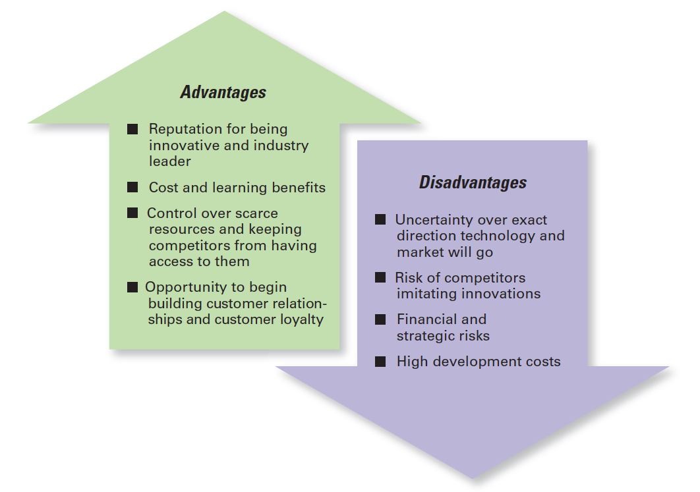
figura 9-6 vantagens e desvantagens de ser o primeiro (first mover)

Slide 41


